Slide 1
Pilgrim Primary Academy Parent and Carer Survey November 2024

Slide 2
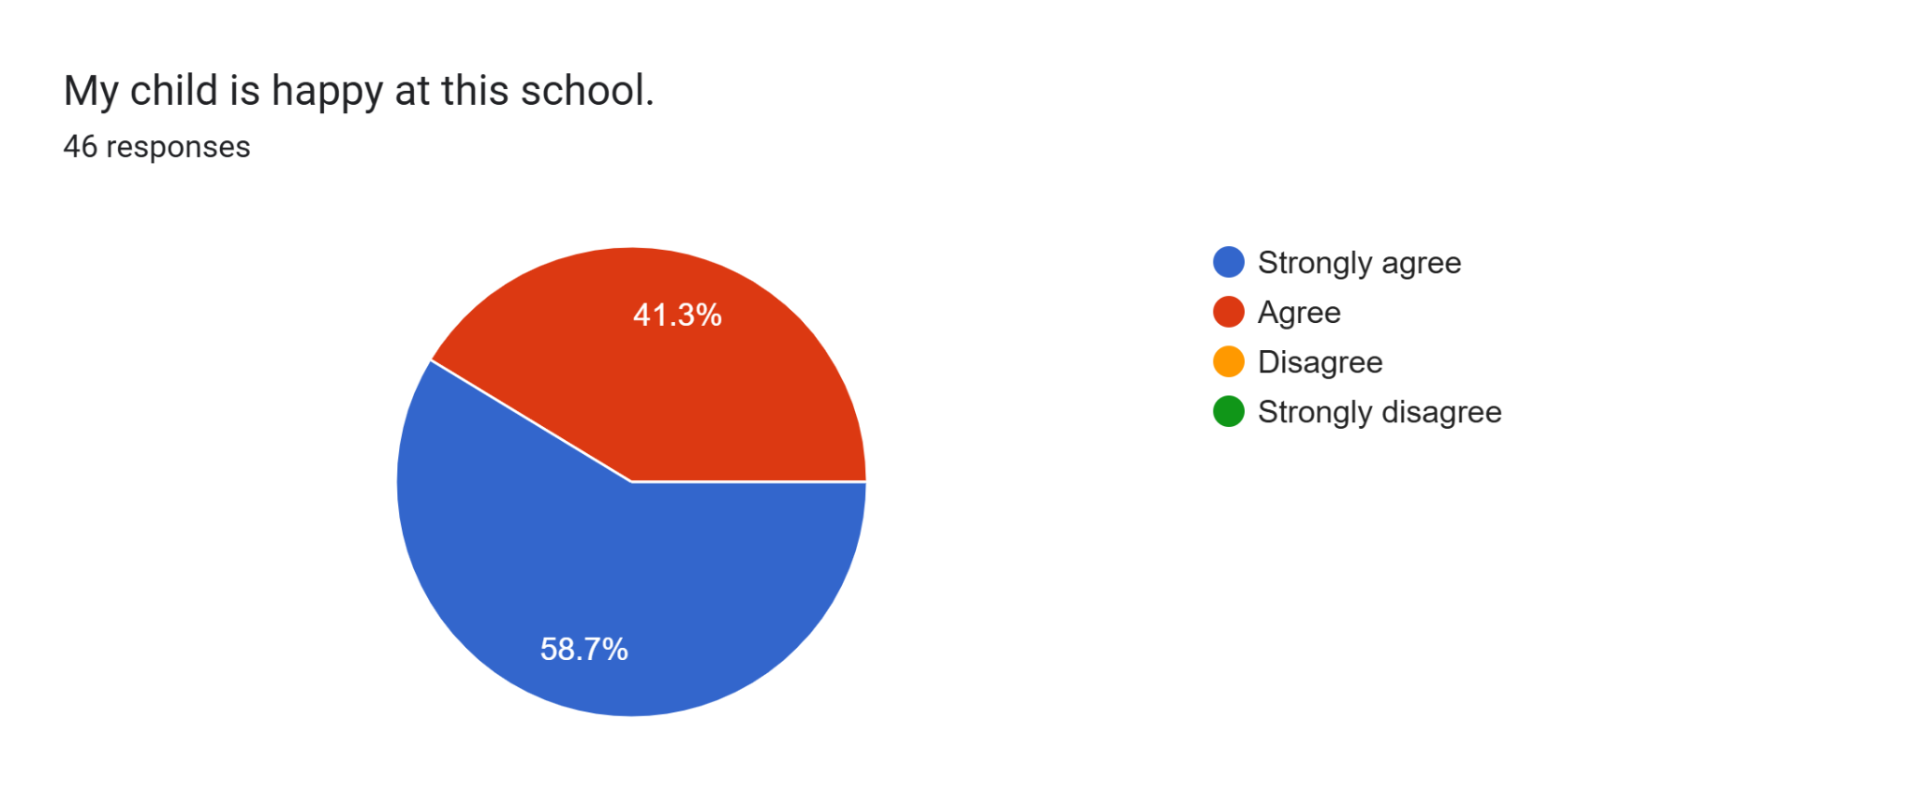

Slide 3
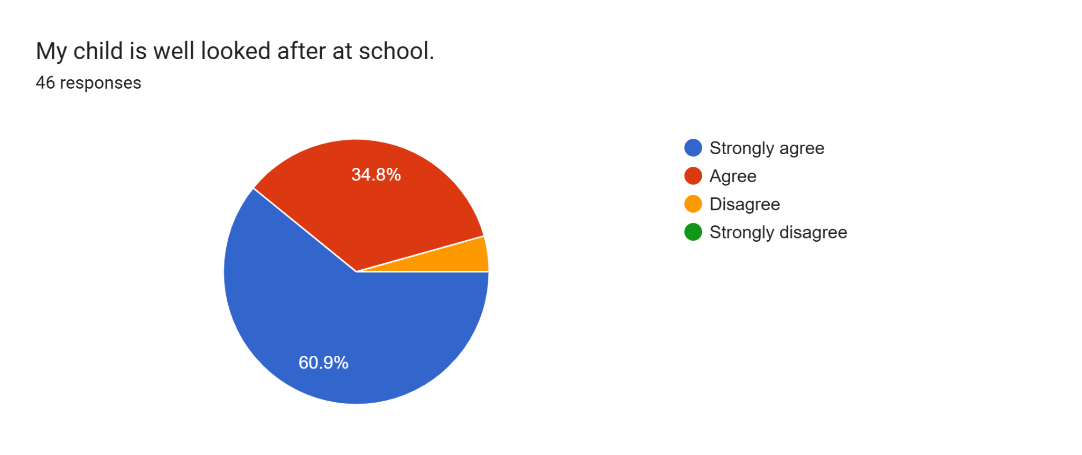

Slide 4


Slide 5
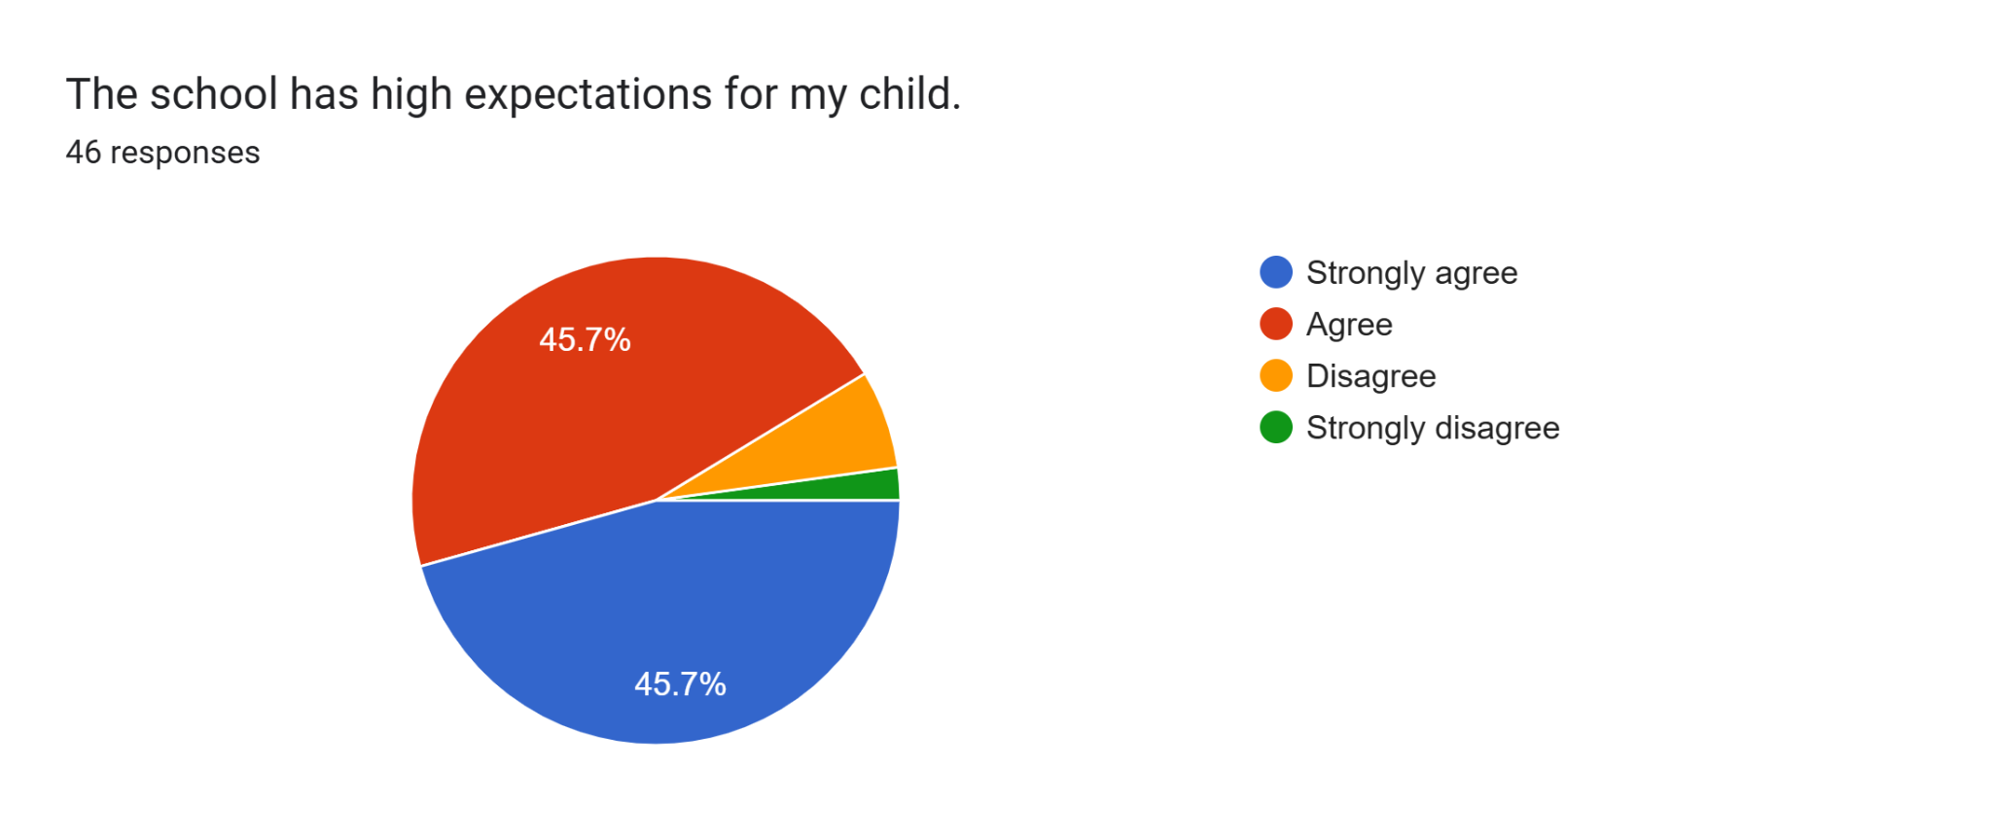

Slide 6


Slide 7
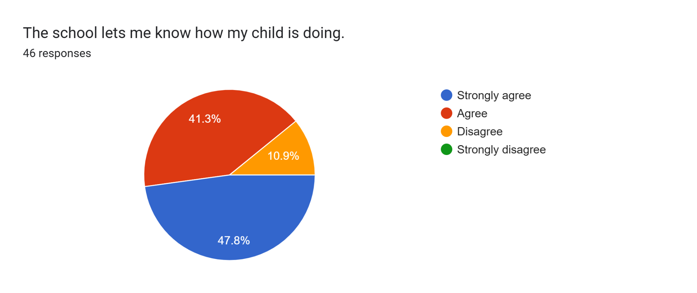

Slide 8
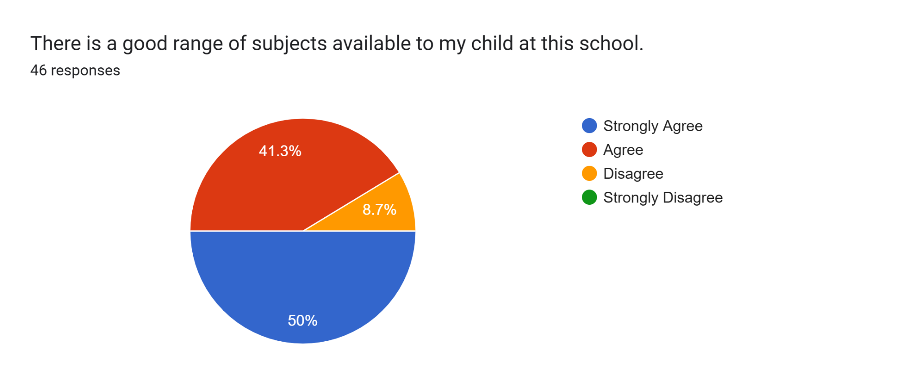

Slide 9
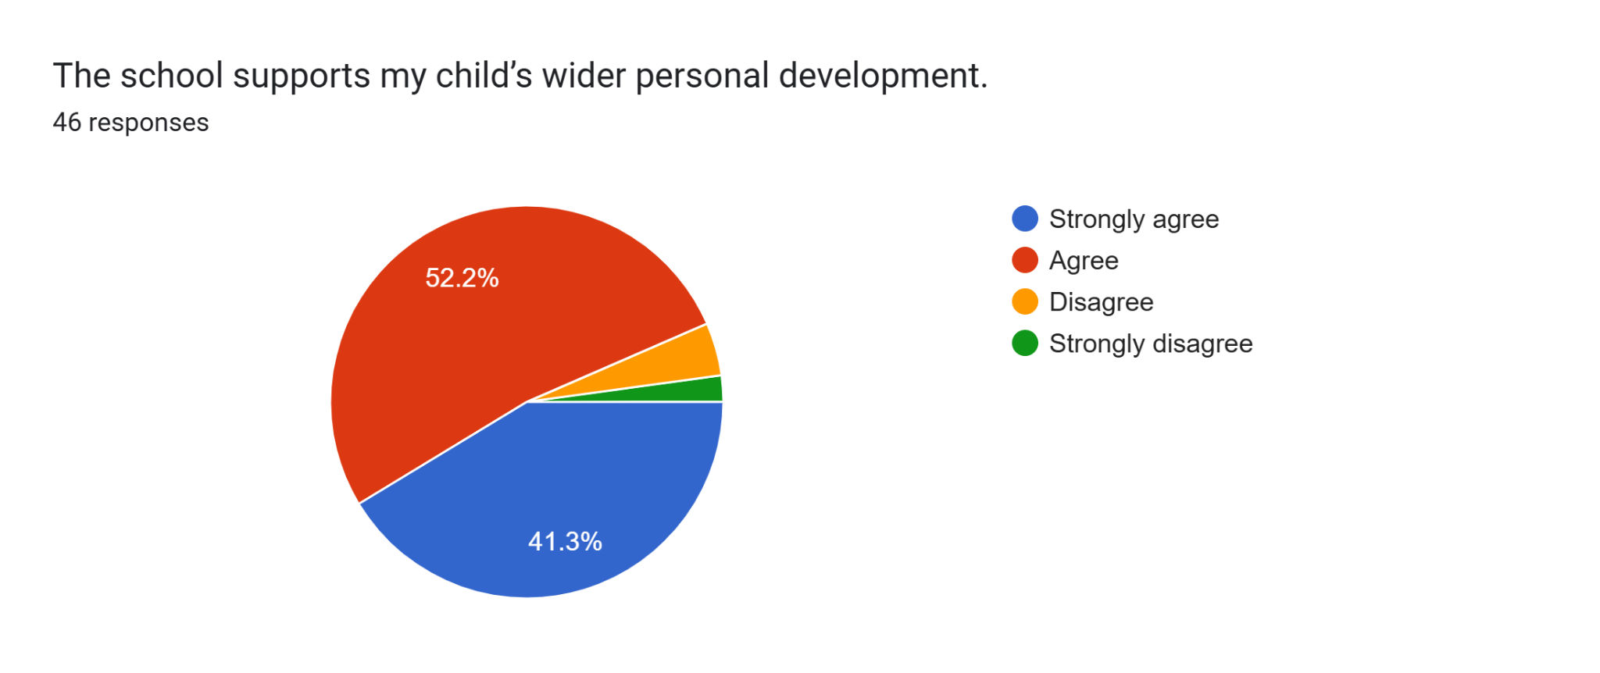

Slide 10


Slide 11


Slide 12
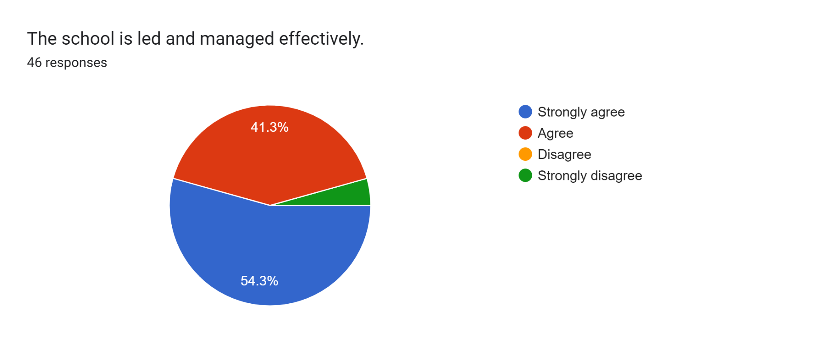

Slide 13


Slide 14


Slide 15
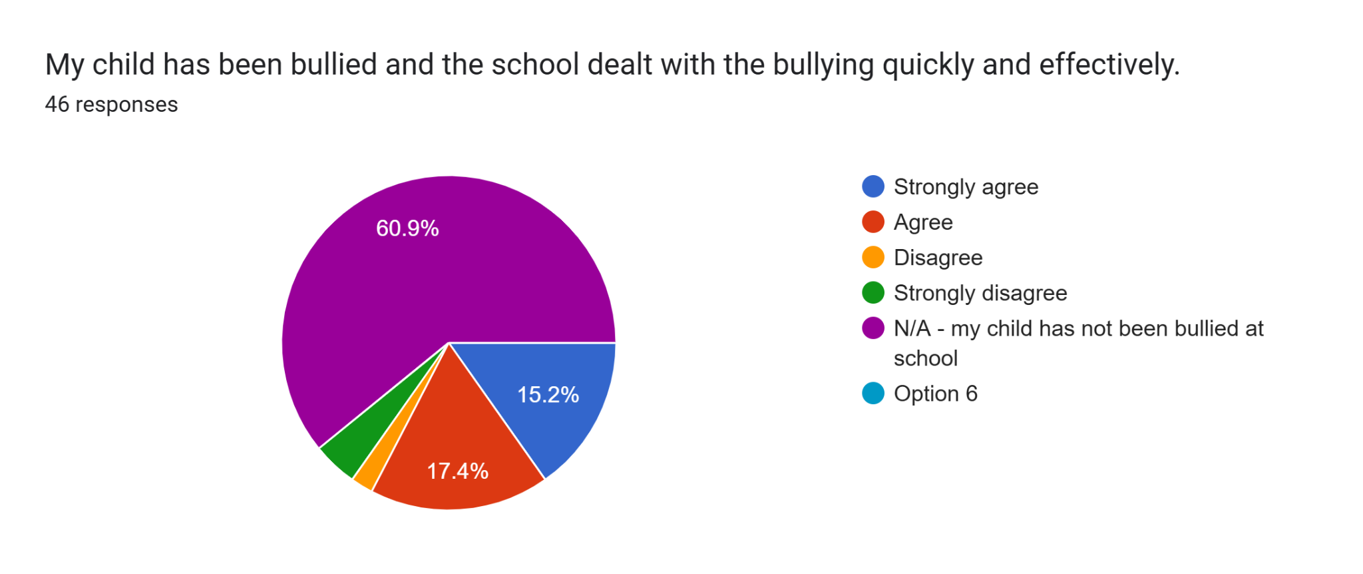

Slide 16
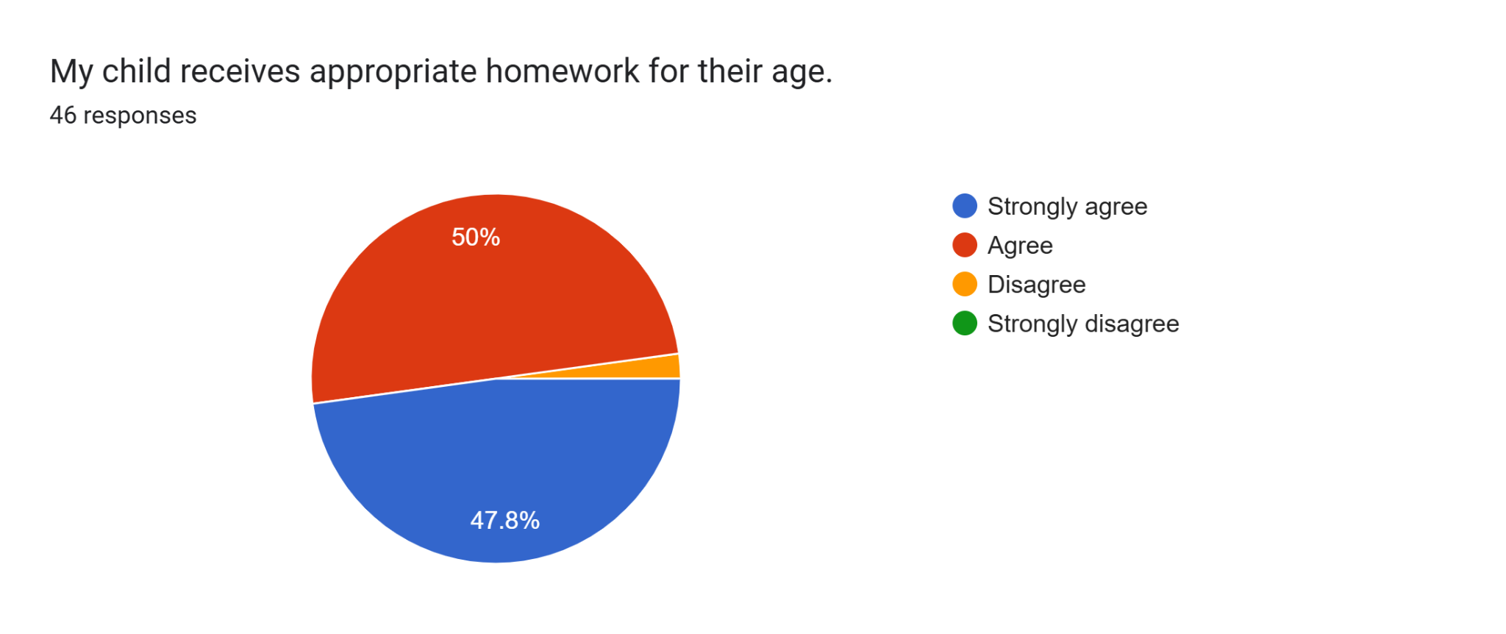

Slide 17
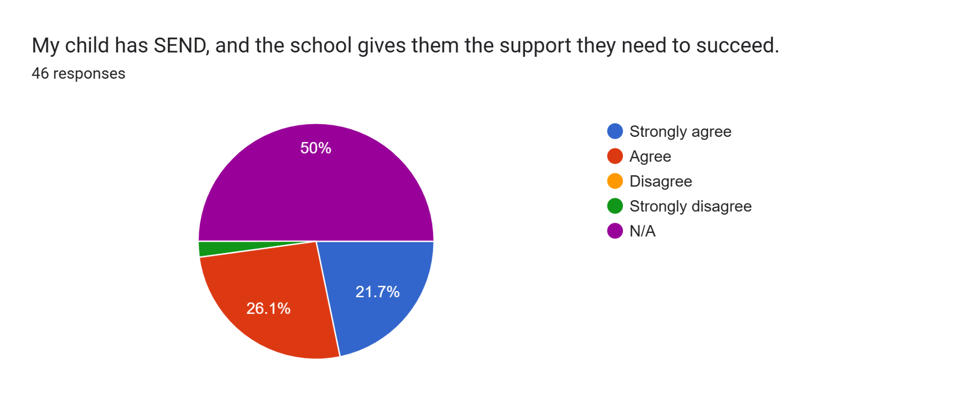

Slide 18
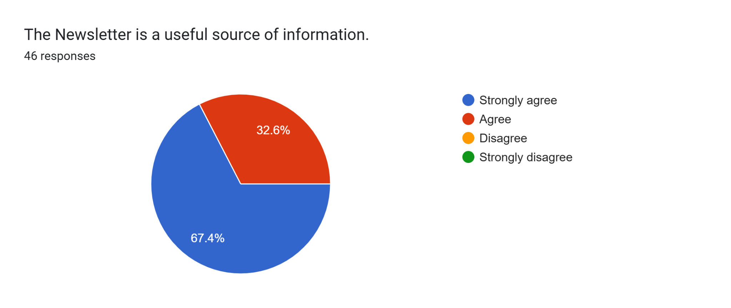

Slide 19


Slide 20
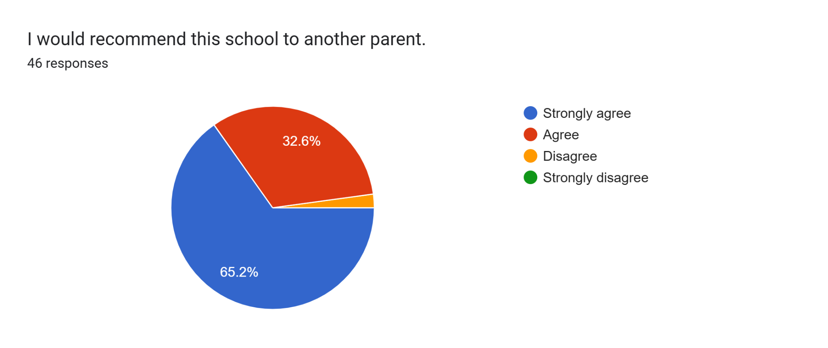

Slide 21
What are our greatest strengths?
46 responses
Communication
I don't see any
Friendly staff especially the pirates lady Miss Farrell
Satisfactory
Friendly approachable staff and my child enjoys school
Trying constantly to improve
Good communication
Discipline
The teachers are very good, thank you very much.
Thanks

Slide 22
Thanks
Thank you
A great team of teacher who are committed to their jobs
Attendance
friendly accepting environment with good education
Excellence
Determined to get it right
Supportive
Fantastic school
developing the child's skills
taking care of the child's well-being
Positive relationships with children
Safety
Diversity school
Kind, caring staff

Slide 23
Communication between teachers and parents has significantly improved, making it easier for parents to stay informed and engaged.The librarians are doing an excellent job by offering books for children to read at home. Allowing children to choose their own books fosters independence and encourages a love for reading.The option for children to choose their own lunch is another thoughtful initiative that empowers them to make decisions and promotes healthy eating habits.The reading challenges have been fantastic for pupils and the school community. They motivate students to develop strong reading skills and celebrate their progress.
Very good SEND and information on the development at school
Communication. Working well with parents. Children well looked after.
I love the way school make sure that all pupils are well behaved
Safety, learning (best learning environment)
Discipline, equality, democracy, passionate and kind teachers
Teachers are supportive and friendly enviroment in the school

Slide 24
Inclusion
Well organised
Diversity
Friendly helpful and all round good school
My childs are met her learning has been adjusted
Everything 🙂
Happy with all subjects.
Administration
Teachers are very welcoming

Slide 25
What are 3 areas we should work on next year
46 responses
Thanks
Nothing
None
Communication, approachability, care and compassion
Play ground difficulties
Bullying
Equality
Improving on existing standards on child wellbeing
Keeping children’s shoes on whilst doing indoor pe because they keep getting warts
Clearness. It is never clean, either corridors or other places. Children should not be asked to do PE barefeet on a duty surface with food.
Break time. : I am appealed of the fact that they are not allowed to run, jump, play with a bo, jumping rope ect. There are not childhood games. If they run, they are yelled at. This is a school from what I remember. It doesn't sound like it

Slide 26
Leadership
A bit tolerant with both parents and pupils
Thanks
No idea
Letting parents be aware of what their their will learn in advance .
Giving weekly feedback to parents on their children performance.
Conducting an open day
Idk
Meal. Most of the children trash the food because they don’t like it
When a parent comes to pick their children, constant feedback about behaviour and performance of child should be given
Is it possible that the teacher that begins year 1 with a child continue with the class until year 6, please.
More child led learning, physical notes/newsletter from school, opening the gates on time.
more outdoor activities

Slide 27
Unsure
Unsure
More option for activities to join
Keep on doing the good work
More clubs for the younger years to attend.
Targeted Homework:
Providing more homework, particularly special assignments designed to target and improve students' weaker subjects, would be beneficial. This approach could help children focus on their specific challenges and make consistent progress.
Healthy Snacks:
It would be great if more healthy snack options were available during both snack times. Many children feel quite hungry as soon as they reach home, and offering nutritious snacks at school could help sustain their energy and focus throughout the day.
Activity Clubs:

Slide 28
The variety of activity clubs available for students to choose from is currently limited, and the schedule for these clubs often changes. If the school could offer a wider selection of clubs with fixed days, it would be easier for students to plan and participate. Additionally, providing certificates or recognition for club participation would encourage students to continue these activities outside of school.
Keep the communication going
Cultural activities, More creative works
More support from Send teachers
Discipline, Effective strategies for misbehaviour
Little more concentration on extra curriculum activities, Regular use of google classrooms to let parents know specifically about child's progress.
Shelter for kid line up
All good in my opinion
Parent involvement
More home work
Strict with uniform
No coment

Slide 29
Are there any other comments you would like to make?
25 responses
Thanks
Satisfactory
Well done pilgrim
This school can do better. Take examples from other countries
I support from form my heart all the teacher and other stuff all their hard work
I really love the school and happy that my kids where given the opportunity to be there
If the child has an event, for example Christmas, you should let us know 3-5 days before. We need to make preparations. For example, I need to buy clothes.
Thanks
No

Slide 30
I think there is something off in 2 Penguins. I don’t know what it is but my son is scared of the teacher.
He just told me yesternite this terms alone, first half that they have spent in school, she had denied him of playtime for like 10 times and she exempts the boy she caught him talking with, Max.
My son is Victor.
He also does not want to tell her if he has some challenge in his work neither does he want us to speak with her and all these were not like that with Ms Mathews. He was always happy with us discussing with her or by himself
Kindly help look into it
All we truly know is that we know nothing.
No
My child reported about another child hitting her and nothing was done
God bless you all
While most teachers are respectful and professional, some instances of inappropriate communication with students have been reported. For example, when students are silly, some teachers respond in a rude manner. In one case, a student felt insulted when told, “It’s none of your business” in an unpleasant tone. It was by an assistant teacher. As a parent, this is concerning, and I hope the school can address such situations to ensure respectful communication at all times.
Offer English as a Second Language (ESL) classes for parents, tailored to everyday school-related communication. Offer translated materials.Use WhatsApp groups, social media, or school apps to facilitate communication between parents in the same year group.
I aways praise this school. I have always been happy with my children here. The staff are fantastic
All seems good so far
Keep doing what you doing now

